Slide 1
Programmable peripheral interface 8255
PPI 8255 is a general purpose programmable I/O device designed to interface the CPU with its outside world such as ADC, DAC, keyboard etc.
We can program it according to the given condition.
It consists of three 8-bit bidirectional I/O ports i.e. PORT A, PORT B and PORT C. We can assign different ports as input or output functions.
HEMANT SINGH POKHARIYA, A.P. CSE DEPT.GRAPHIC ERA DEEMED TO BE UNIVERSITY DEHRADUN

Slide 2
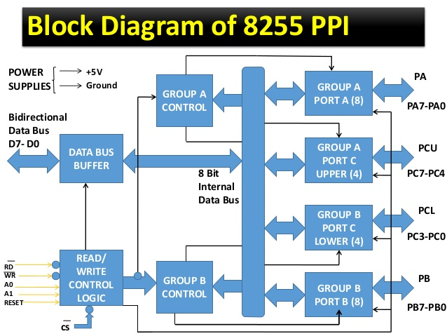
Programmable peripheral interface

Slide 3
Operating modes of 8255
Bit set reset (BSR) mode – If MSB of control word (D7) is 0, PPI works in BSR mode. In this mode only port C bits are used for set or reset.
Input-Output mode – If MSB of control word (D7) is 1, PPI works in input-output mode.
Mode 0(Simple I/O function):PA,PB and PC work
Mode 1(Handshake I/O ):either port A or port B
Mode 2(Bi-directional data bus mode)Only port A

Slide 4
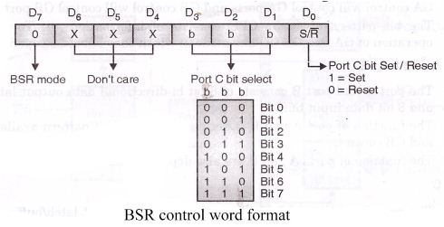
Control word of 8255 in BSR Mode
HEMANT SINGH POKHARIYA, Astt.Proff. CSE DEPT
GRAPHIC ERA DEEMED TO BE UNIVERSITY DEHRADUN

Slide 5
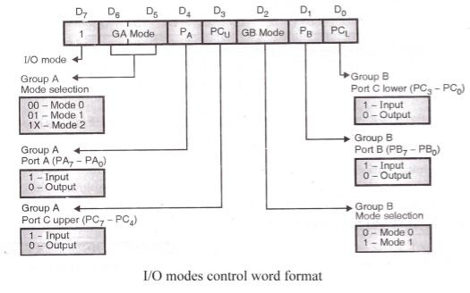
Control word of 8255 in IO Mode
10010010

Slide 6
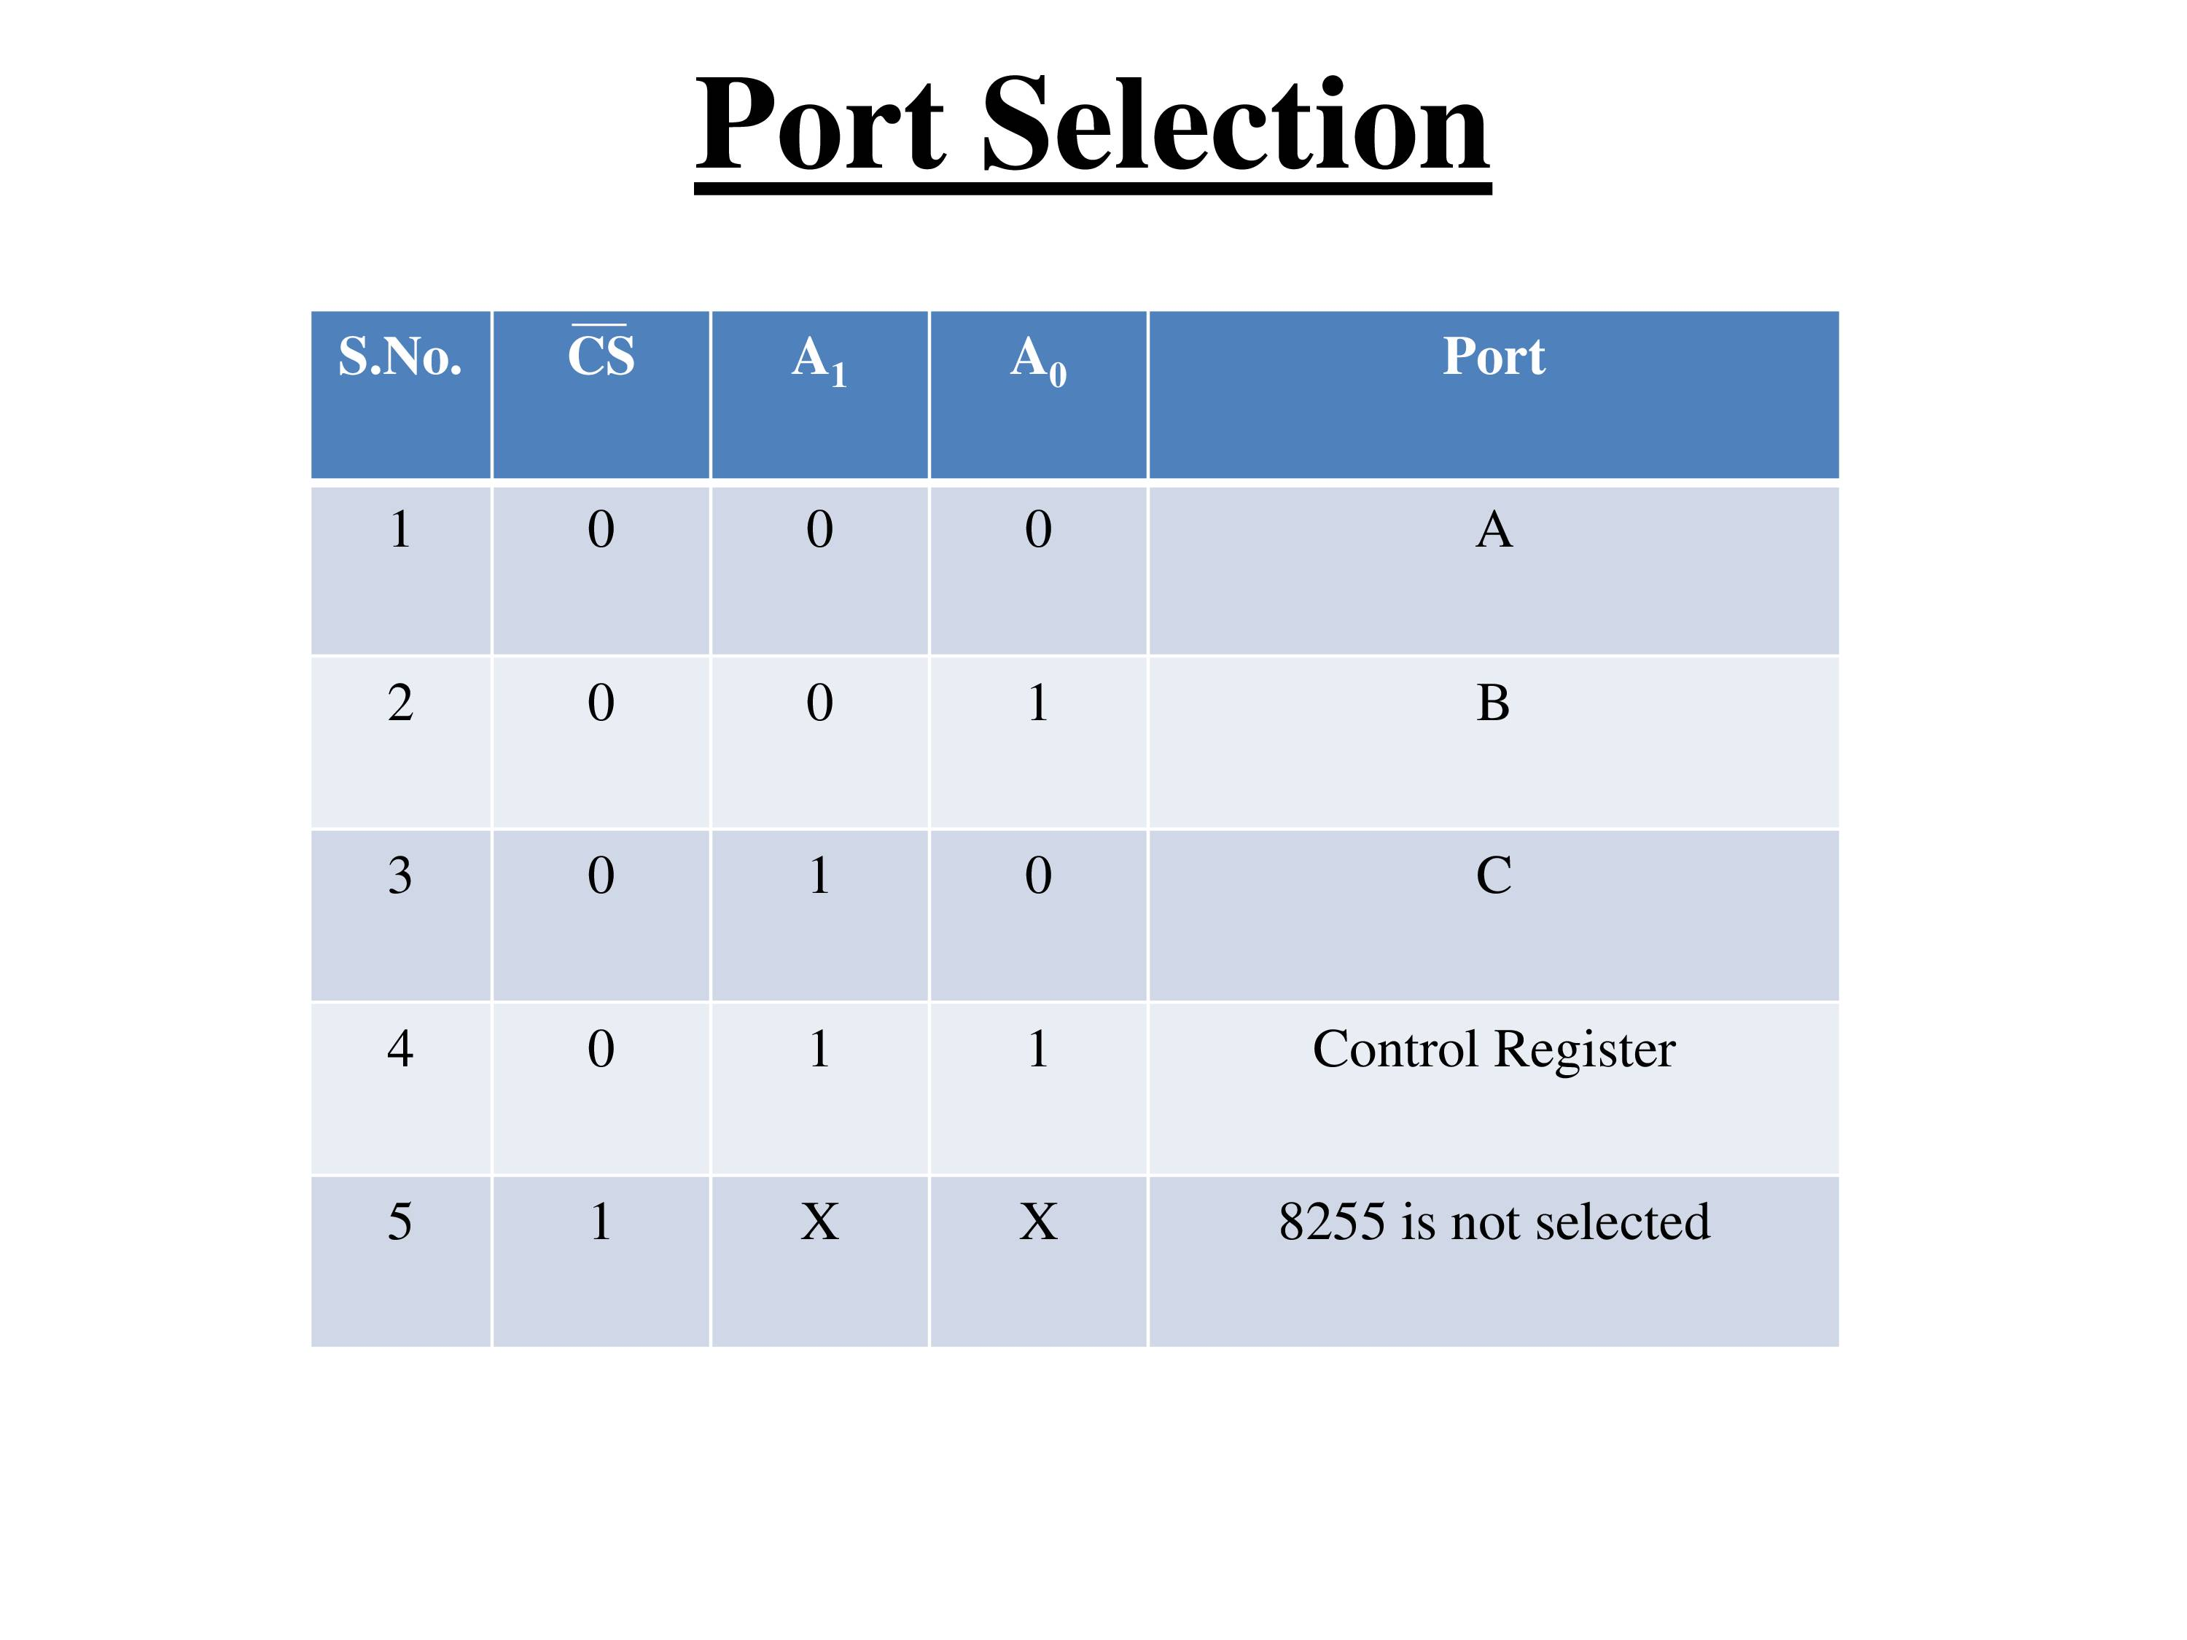

Slide 7
Determine sum of contents of PA and PB and store the result in PC of 8255
PA and PB are in mode 0 and as i/p function
PC is work in mode 0 and as output function
Control word=92H
Suppose port address are PA=80H,PB=81H,PC=82H,CR =83H
MVI A 92
OUT 83
IN 80
MOV B,A
IN 81
ADD B
OUT 82
RET

Slide 8
Thanks For Watching

